Slide 1
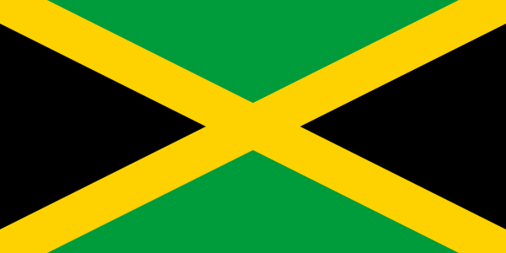
SGC International Café (SGC インターナシナルカフェ）
Learn Jamaica and use your English.
( ジャマイカ国について知ろう、そして英語を使おう）
*Rf.W

Slide 2
Welcome to “ SGC International Café”
Introduction of this session by SGC Host (Yoshi)
Thank you for coming.
Purpose: Learn English and learn foreign culture together with enjoying tea.
Today`s Topic: Learn about Jamaica.
Do you know that Jamaica is a big English speaking country .
Let`s learn something about Jamaica.
Let`s explore your view on the world and English.

Slide 3
Today`s agenda:
Introduction of today`s instructor
Explain how to proceed this session
Explore Jamaica:
What you know about Jamaica?
Fundamentals: location, geography, climate,
major cities & population, history, industry,
people, language, culture, sports, recommended
sight seeing spots, any other interesting topics
or items., etc.
How to get to Jamaica?
Marsha san’s best 5 recommendations to visit in Jamaica.
Questions and answers.

Slide 4
Introduction of Instructor:
Ms. Marsha
How long have you been in Japan?
What is your job now?
Where do you live?
What is your hobby?
What do you like about Japan?
What do you think that we, Japanese, need to
improve?
How to proceed this session?
- SGC will cover overview and ask the instructor (Marsh) to
add anything special.
- At the end, SGC will give some questions to today`s
participants on what they have learned today.

Slide 5
Explore Jamaica!
If anyone has any information on Jamaica, please share with us?

Slide 6
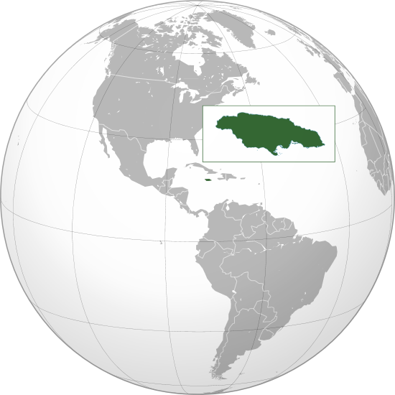
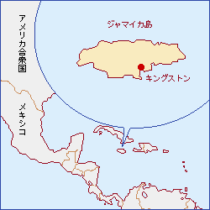
Jamaica Fundamentals
location:
*Rf.W
*Rf.JF
Located in the Caribbean Sea. Spanning 10,990 square kilometers in a area (same as Akita Prefecture (*NF).
The third-largest island of the Greater Antilles and the Caribbean (after Cuba and Hispaniola(include Haiti and the Dominican Republic).
*Rf.W

Slide 7
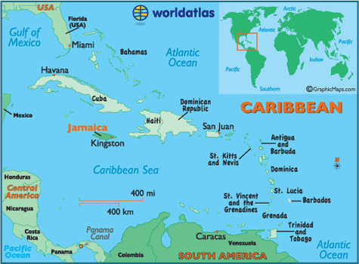
*Rf. A

Slide 8
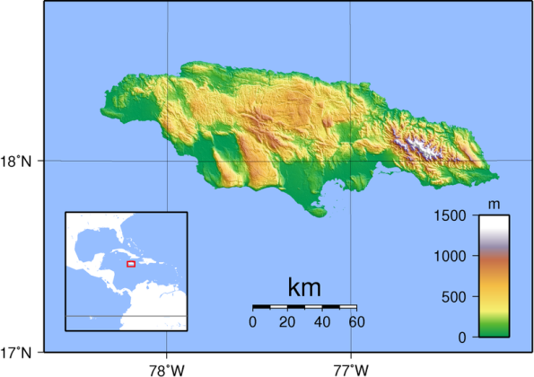
Jamaica Fundamentals
Geography, climate:
Dry Harbor Mountain
Blue Mountain&
Blue Mountain Peak(2256m)
*Rf.W

Slide 9
Geography:
Mountains dominate the interior:
- West - The Don Figuerero, Santa Cruz, and May Day
mountains
- Center - The Dry Harbour Mountains
- East - The John Crow Mountains and Blue Mountains,
containing
- Blue Mountain Peak, Jamaica's tallest mountain at 2,256M.
Surrounded by a narrow cost plain. The shape of Island is like a fish.
Climate:
Climate is tropical, with hot and humid weather;
- Higher inland regions are more temperate.
- Some regions on the south coast are relatively dry rain-
shadow areas.
Jamaica lies in the hurricane belt of the Atlantic Ocean and has encountered several serious hurricanes in the past.
*RFW

Slide 10
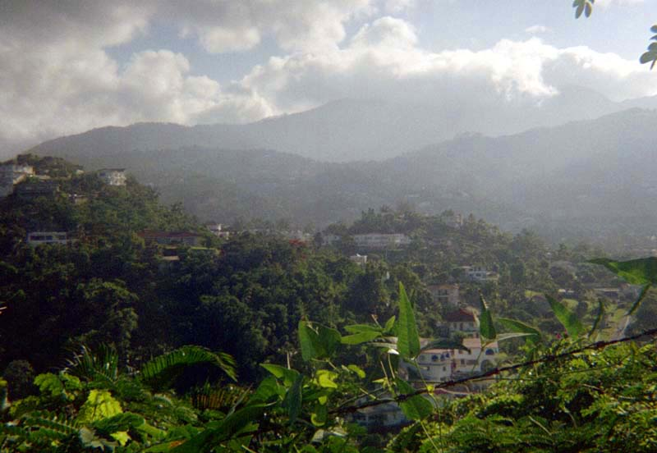
Blue Mountain
*Rf.W

Slide 11
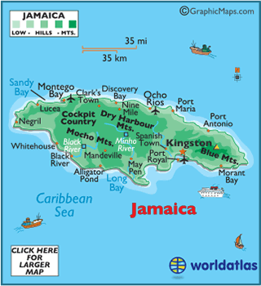
Jamaica Fundamentals
Jamaica Cities:
*Rf.W

Slide 12
Jamaica Major Cities & Populations:
Total Population of Jamaica is about 2.9 million in 2017.
Jamaica is divided into 14 parishes.
Kingston( population of 661,862), the capital city and center of business, located on the south coast .
Montego Bay(P:110,115) is one of the best known cities in the Caribbean for tourism, located on the north coast.
Kingston Harbor is the seventh-largest natural harbor in the world.
Other towns of note include Portmore(P:182,153), Spanish Town(P:147,152), Savanna la Mar, Mandeville(P:49,695) and the resort towns of Ocho Ríos(P:16,671), Port Antonio and Negril.
*Rf.W

Slide 13
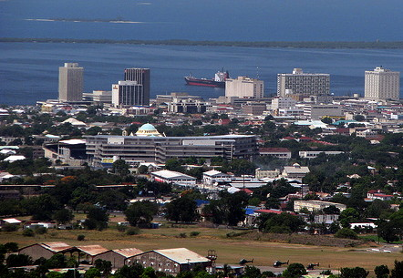
Kingston
*Rf.W

Slide 14
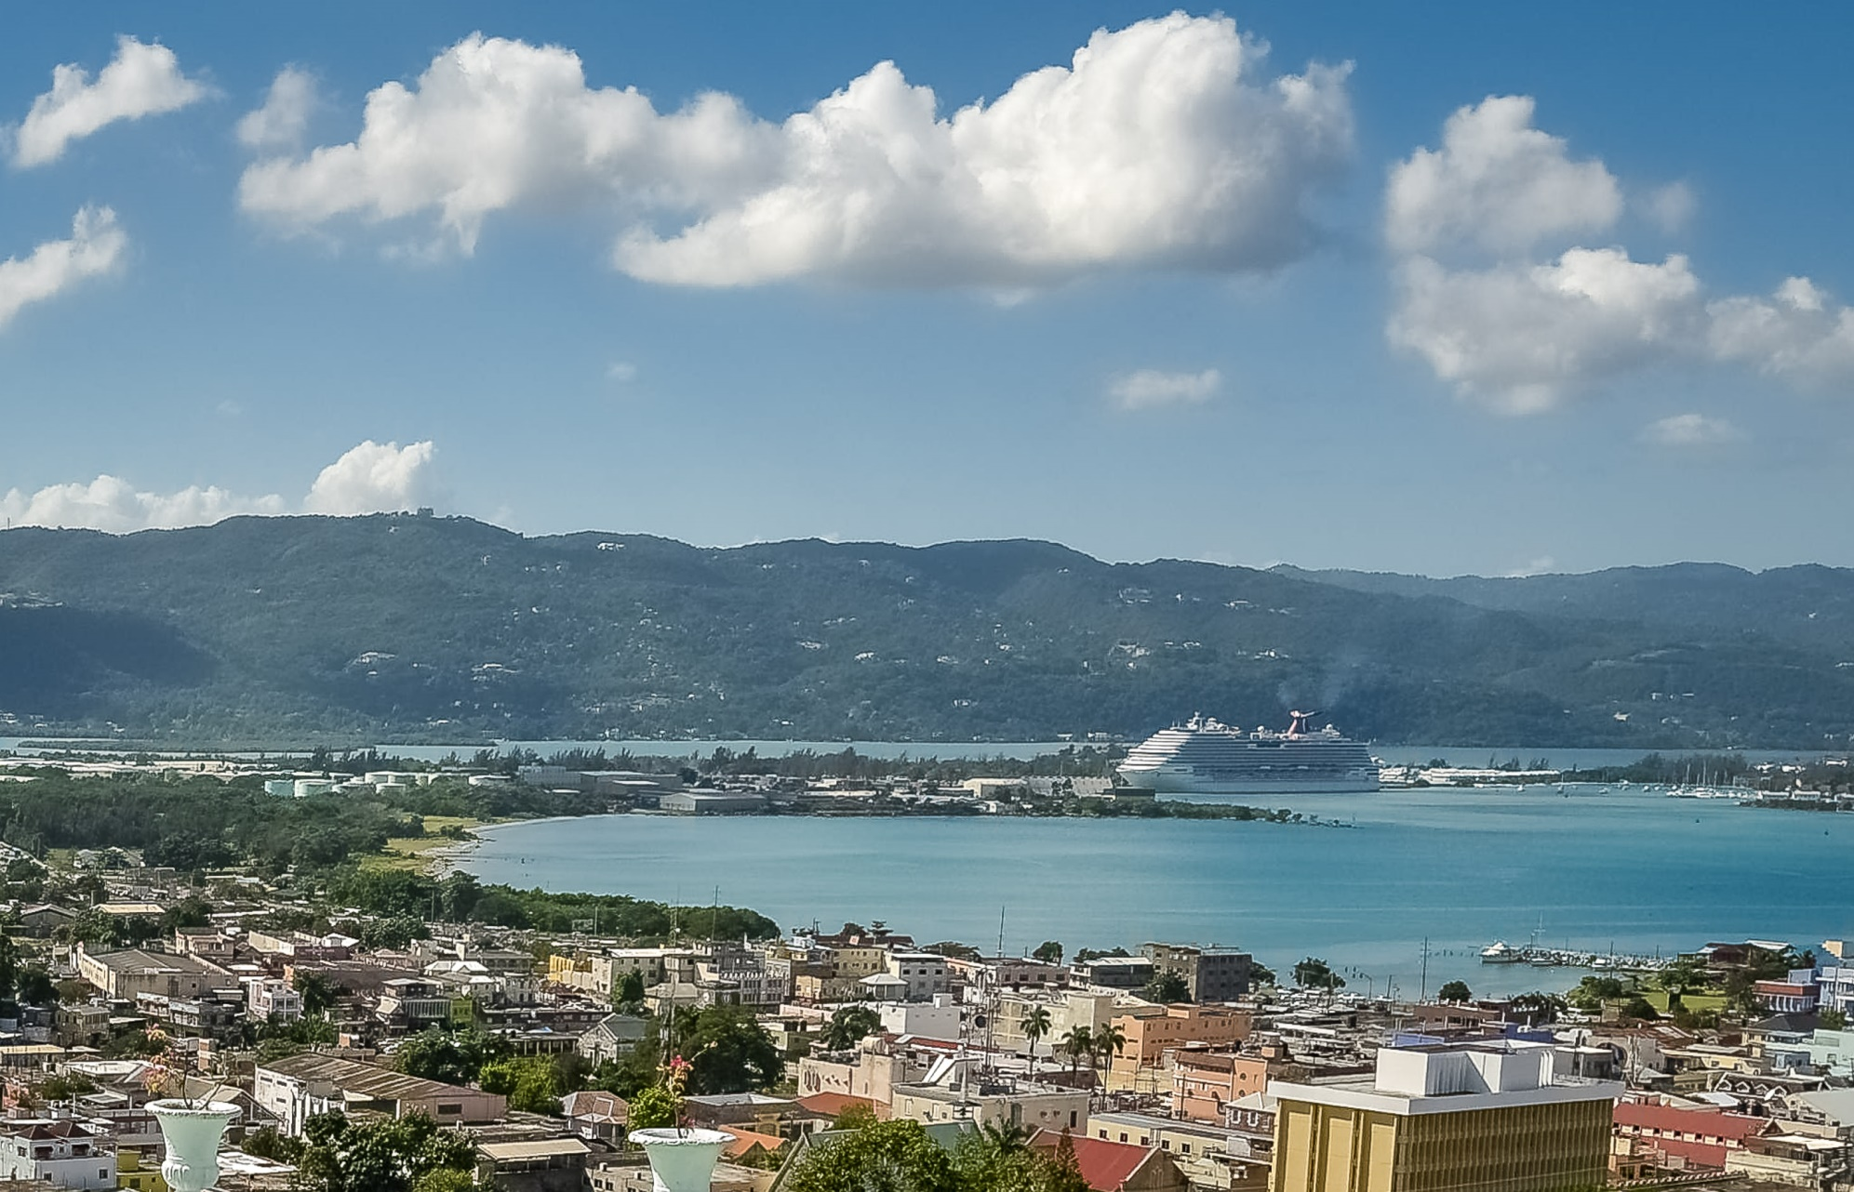
Montego Bay
*Rf.W

Slide 15
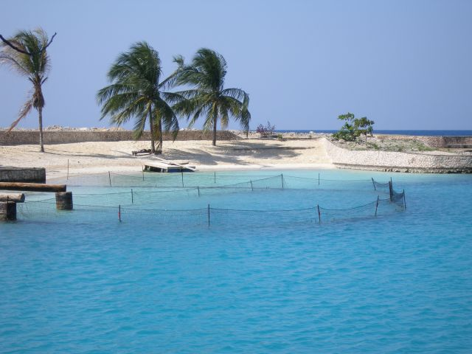
James Bond Beach Oracabessa
*Rf.W

Slide 16
Brief History of Jamaica(*RFW)
Year | Brief History
1494 | Christopher Columbus in 1494 found Jamaica on his way on his second voyage to the America. He was here again in 1503.
1670 | Spanish ruled the country until 1655. But the English won the battle with Spanish in 1655 . The English admiral Sir William Penn, the father of William Penn who established the Pennsylvania in U.S. , led this war. After 1655 war, the English take over Jamaica from Spain.
1944 | A new House of Representatives was established in 1944, elected by universal adult suffrage.
1957 | Jamaica slowly gained increasing autonomy from the United Kingdom. In 1958 , the Jamaica obtained autonomy as the member of the Federation of the West Indies, a federation of several of Britain's Caribbean colonies.
1962 August | Jamaica attained full independence on 6 August 1962 from England with condition its membership in the Commonwealth of Nations (with the Queen as head of state) and adopted a Westminster-style parliamentary system. First independent country in the Caribbean.

Slide 17
Industry & People
Industry :
Major industry in Jamaica is tourism with an average of 4.3 million
tourists a year with beautiful cost lines and very good resort facilities.
Also mining industries, agricultural industries are big exposure in its economy.
People: Out of may one people. Total of about 2,812,000 (July 2018)
- Black or Black Mixed (African Origin) 92.1% (2,661,965)
- Mixed non-Black 6.1% (176,308)
- Asian (Indian & Chinese origin) 0 .8% (23,122 )
- Other 0.4% (11,561 )
- Unspecified 0.7% (20,232)
*Population constitution relating to its country history :
Plantation type industries in the past (slavery) and relating to English
colonies (China and India).
*Rf.W

Slide 18
Language
Language:
- Two key languages: English and an English- based creole called Jamaican Patois (or Patwa).
- English is used in all domain of public life.
- Jamaica is the third-most populous English
used country in the Americas (after U.S. and
Canada).
*Rf.W

Slide 19
Culture
Though a small nation, Jamaican culture has a strong global presence:
Music: Reagga: BOB Marley, a famous Jamaican singer and songwriter. Many other internationally known artists were born in Jamaica.
Cuisine: Jamaican jerk spice, curries and rice and peas which is integral to Jamaican cuisine. Also, Home to Red Stripe beer and Jamaican Blue Mountain Coffee.
Sports: Popular sports are crickets, international presence in tracks and field athletics, world class amateur and professional boxers.

Slide 20
Culture
Sports: Tracks: Usain Bolt – 100M, 200M Olympic Gold medalist (2008, 2012, and 2016), Eliane Thompson – Rio Olympic Woman`s 100M, and 200M gold medalist; Asafa Powell – 100M world records holder and 2008 Man 100M gold medalist.
Professional boxers especially in U.K. (Jamaican born or Jamaican parents). Mike Tyson (Ex-World Heavy weight boxing champion).
Education: Education is free from the early childhood to secondary levels (Ages 10 – 19 years.)
*Rf.W

Slide 21
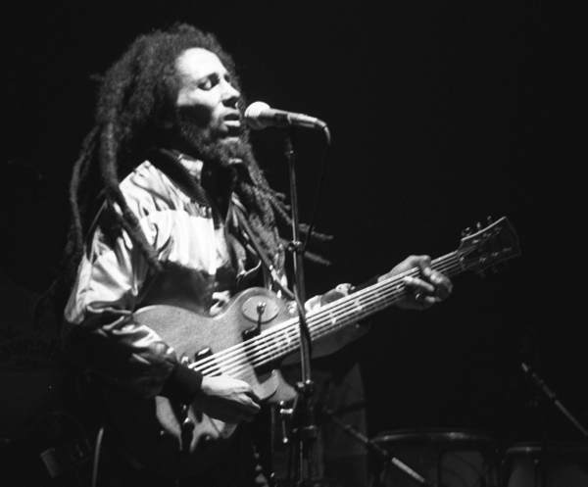
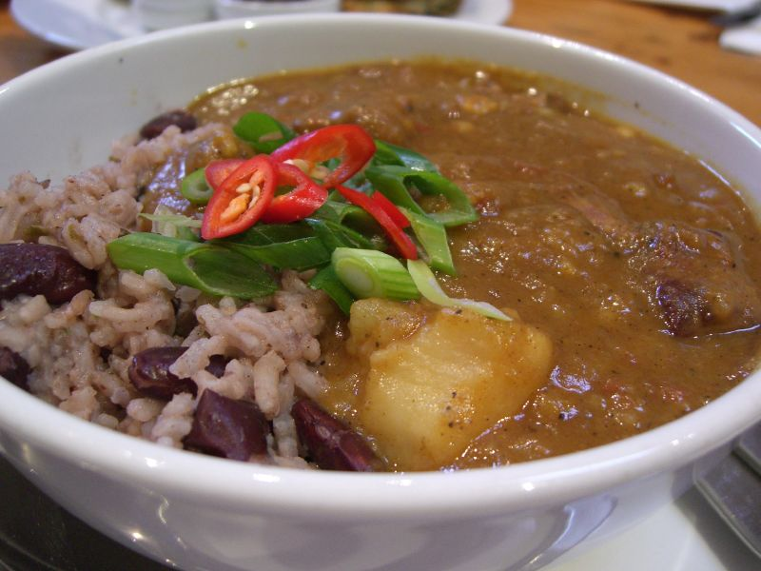
BoB Marely
Jamaican jerk spice
*Rf.W

Slide 22
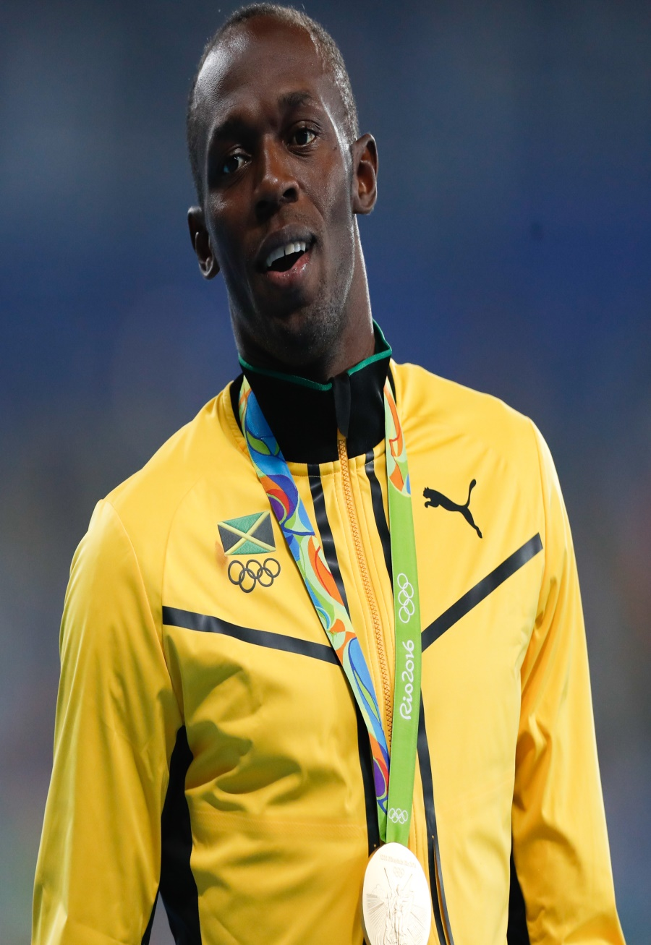
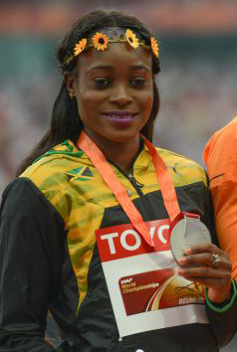
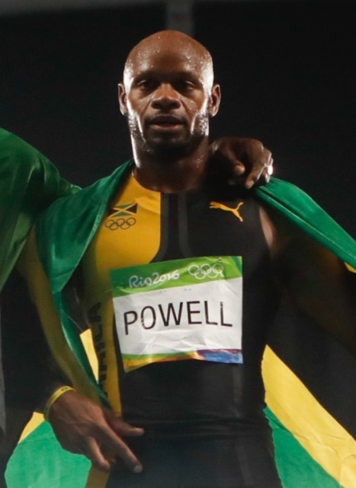
Usain Bolt
Eliane Thompson
Asafa Powell
*Rf.W

Slide 23
Sightseeing Place
1. Kingston. Kingston is the capital of the island of Jamaica, lying on its southeast coast. In the city center, the Bob Marley Museum is housed in the reggae singer’s former home. Nearby, Devon House is a colonial-era mansion with period furnishings. Hope Botanical Gardens & Zoo showcases native flora and fauna.
2. Montego Bay. Montego Bay, the capital of Saint James Parish on Jamaica’s north coast, is a major cruise ship port with numerous beach resorts and golf courses outside its commercial core. Popular beaches include Doctor’s Cave Beach and Walter Fletcher Beach, home to an amusement park.
3.Negril. Negril is a town in western Jamaica. It’s known for its miles of sandy beaches on shallow bays with calm, turquoise waters. Seven Mile Beach, particularly the portion overlooking Long Bay, is lined with bars, restaurants and resorts, many of them international and all-inclusive.
*Rf.W

Slide 24
Sightseeing Places
4. Port Antonio. Port Antonio is a city on Jamaica’s northeast coast and the capital of Portland Parish. It’s known as a gateway to nearby tropical jungles, mountains and waterfalls. In the John Crow Mountains, Reach Falls flows into a river pool. Near Hope Bay, Somerset Falls flows on the grounds of a former plantation. In the east, the Blue Lagoon is known for its blue waters, fed by the Caribbean Sea and underground springs
5. Ocho Rios. Ocho Rios is a port town on the north coast of Jamaica. A former fishing village, it’s now a resort with a cruise ship harbor and a busy bay beach that’s lined with hotels. The surrounding parish of Saint Ann is home to rainforest, rivers and waterfalls. Dunn’s River Falls is a terraced, 180m mountain waterfall with lagoon pools, surrounded by trees
6. Falmouth is the capital city of Jamaica’s Trelawny Parish. It's a busy cruise-ship port that lies between Ocho Rios and Montego Bay on the island’s north shore.
*Rf.W

Slide 25
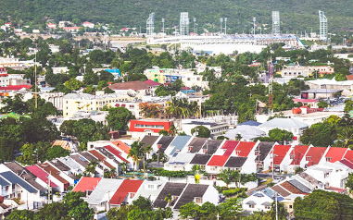
King Stone

Slide 26
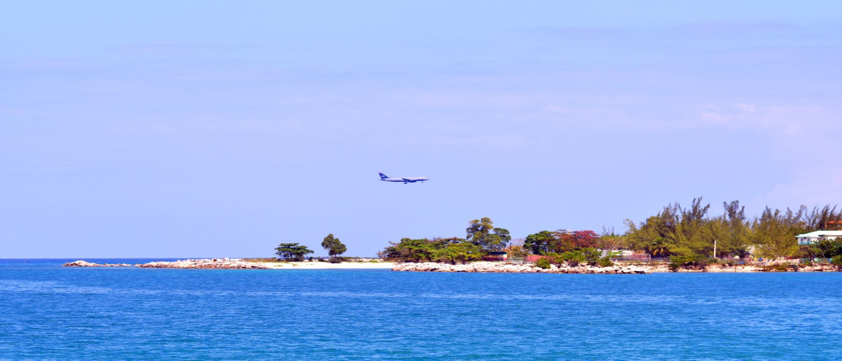
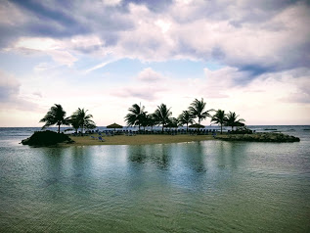
Montego Bay
*Rf.W

Slide 27
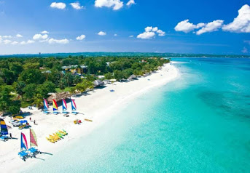
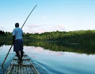
Negril
Port Antonio
*Rf.W

Slide 28
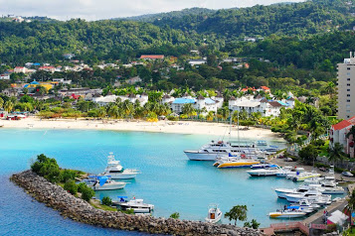
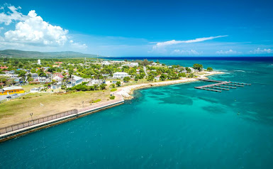
Ocho Rios
Falmouth
*Rf.W

Slide 29
Marsha san`s corner
How to get to Jamaica from Japan and about how long does it take to get to your hometown?

Slide 30
Marsha san’s best 7 recommendations to visit in Jamaica.
1. Dunn’s River falls (Ocho Rios)
2. Bob Museum (King Stone)
3. Boston Jerk center (Portland)
4. Mystic Mountain (Ocho Rios)
5. Port royal (Port Royal Harbor)
6. Rose hall great house*(Montego Bay)
7. Appleton estate* (St. Elizabeth)

Slide 31
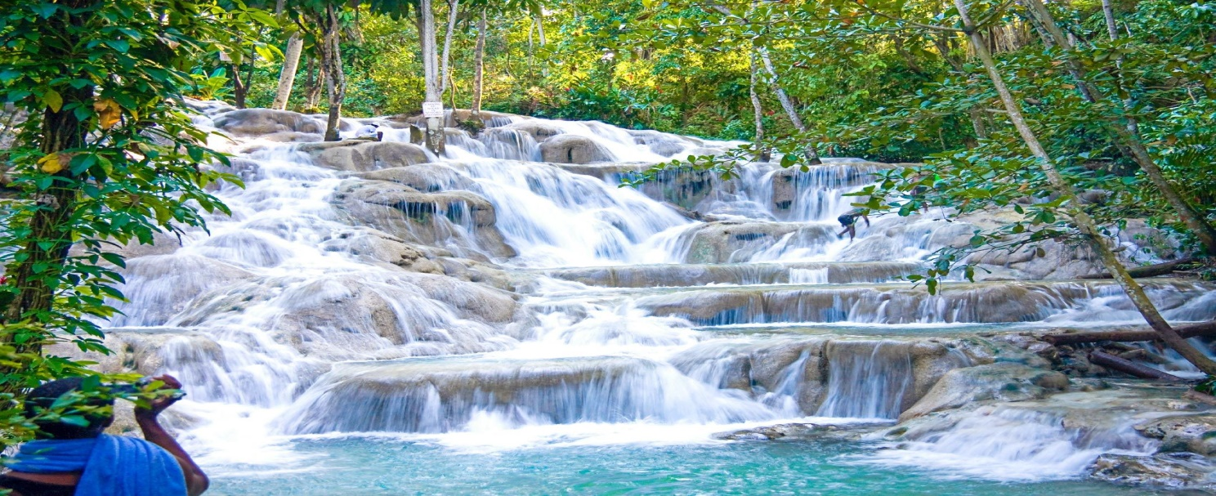
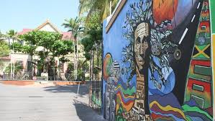
1. Dunn’s River falls (Ocho Rios)(*Google)
2. Bob Museum (King Stone)(*Google)

Slide 32
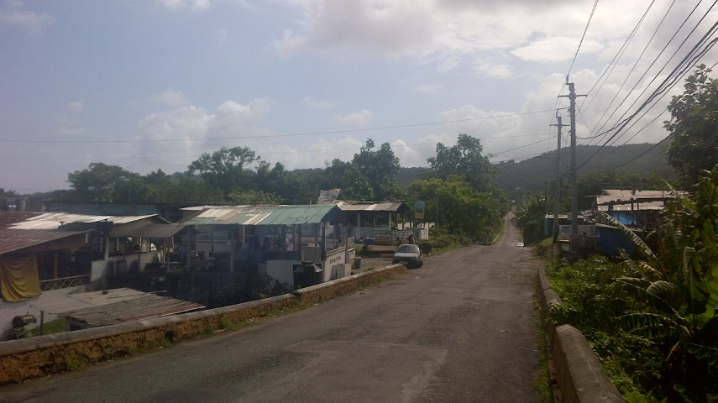
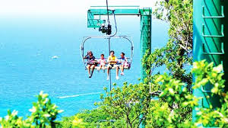
3. Boston Jerk center (Portland)(*Google)
4. Mystic Mountain (Ocho Rios) (*Google)

Slide 33
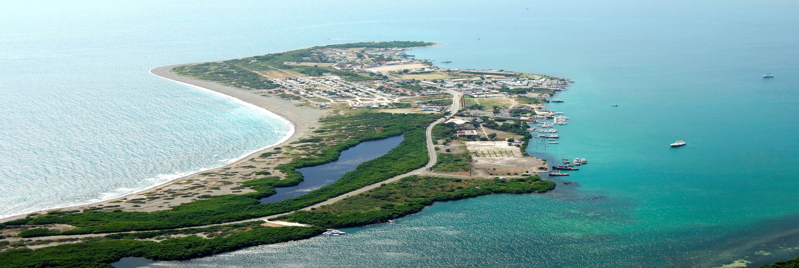
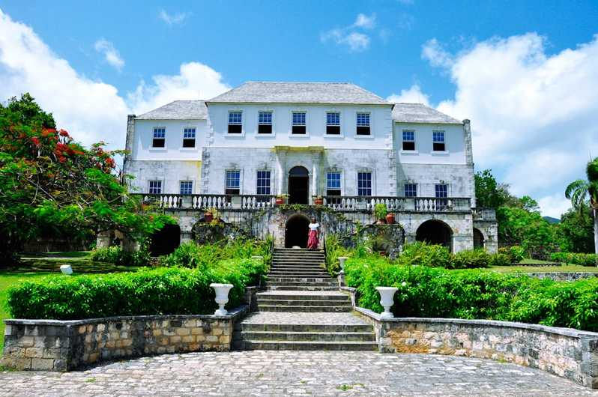
5. Port royal (Port Royal Harbor) *Google
6. Rose hall great house*(Montego Bay) *Google

Slide 34
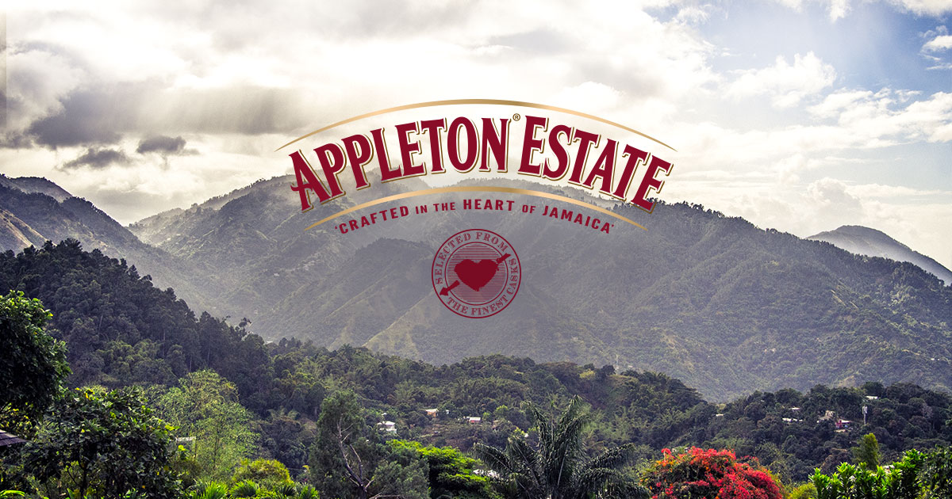
7. Appleton estate* (St. Elizabeth) *Google

Slide 35
Questions about Jamaica
Where is Jamaica located?
What is the name of the capital of Jamaica?
What is the population of Jamaica?
What are the major cities in Jamaica?
What is the climate of Jamaica?
Who is the fist European that visited Jamaica?
What is the famous Jamaican style music?
What are the popular sports in Jamaica?
What are the popular sight seeing spots?
How far from Japan to Jamaica?

Slide 36
Question and answer
Any questions to Marsha on Jamaica?
Free discussion:
Let make a small group
Introduce your-self,
Share your travel experiences:
Best place(s) to visit,
Anything that needs to be paid attention in travel, etc.,
Make a friend if possible.

Slide 37
References
*Rf.W - Wikipedia Jamaica
*Google – from Google.
*Rf.JF – Ministry of foreign affairs of Japan

