Slide 1
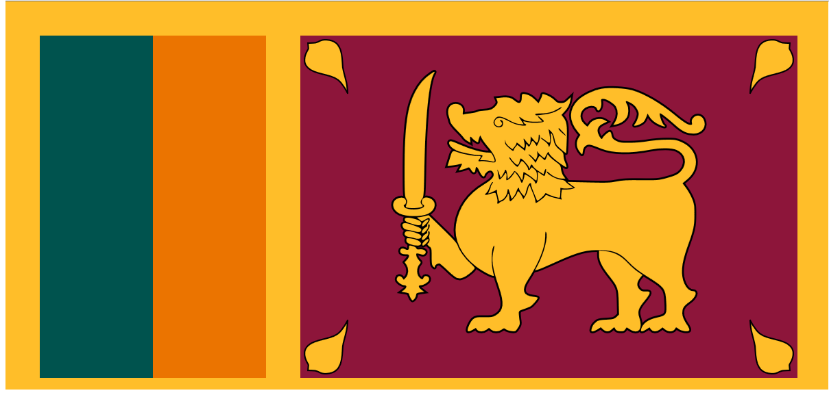
SGC International Café (SGC インターナシナルカフェ）
Learn Sri Lanka and use your English.
( スリランカ国について知ろう、そして英語を使おう）
*Rf.W
Democratic Socialist Republic of Sri Lanka

Slide 2
Welcome to “ SGC International Café”
Introduction of this session by SGC Host (Yoshi)
Thank you for coming.
Purpose: Learn English and learn foreign culture together with enjoying tea.
Today`s Topic: Learn about Sri Lanka.
Do you know that Sanmu City is a host town of Sri Lanka in 2020 Tokyo Olympic.
Let`s learn something about Sri Lanka.
Let`s explore your view on the world and English.

Slide 3
Today`s agenda:
Introduction of today`s instructor
Explain how to proceed this lecture
Explore Sri Lanka:
What do you know about Sri Lanka?
Fundamentals: location, geography, climate,
major cities & population, history, industry,
people, language, culture, sports, recommended
sight seeing spots, any other interesting topics
or items., etc.
How to get to Sri Lanka?
What is the best seasons to visit?
Saji-san`s best 5 recommendations to visit in Sri Lanka.
Questions and answers.

Slide 4
Introduction of Instructor:
Ms. Saji
How long have you been in Japan?
What is your job now?
Where do you live?
What is your hobby?
What do you like about Japan?
What do you think that we, Japanese, need to
improve?
How to proceed this lecture?
- SGC will cover overview and ask the instructor (Ms. Saji) to
add anything special.
- At the end, SGC will give some questions to today`s
participants on what they have learned today.

Slide 5
Explore Sri Lanka!
If anyone has any information on Sri Lanka, please share with us?

Slide 6
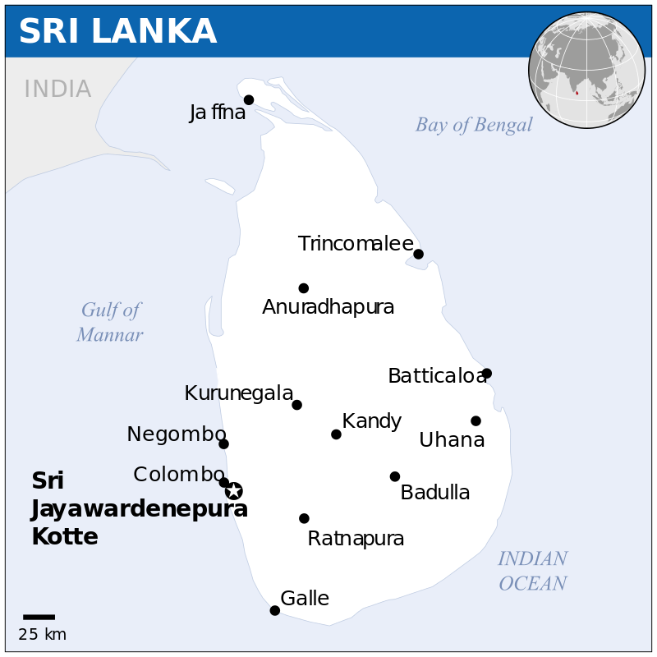
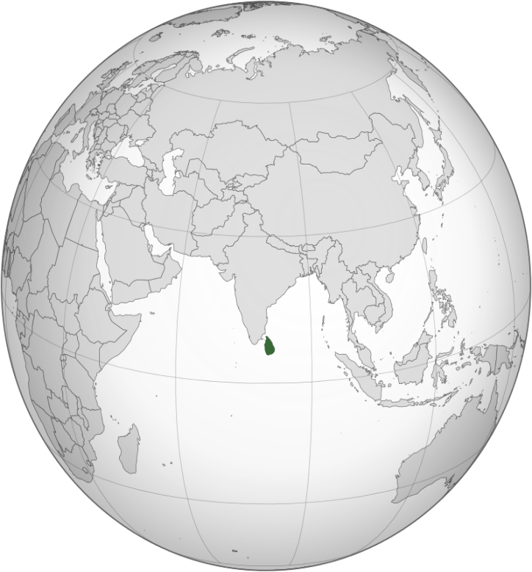
Sri Lanka Fundamentals
Location:
Sri Lanka , officially the Democratic Socialist Republic of Sri Lanka, is an island country in South Asia, located in the Indian Ocean to the southwest of the Bay of Bengal and to the southeast of the Arabian Sea.
The island is geographically separated from the Indian subcontinent by the Gulf of Mannar and the Palk Strait.
The country size is about 65,610 Square Km. (About 0.8 time of Hikkaido) (from JP F)
*Rf.W

Slide 7
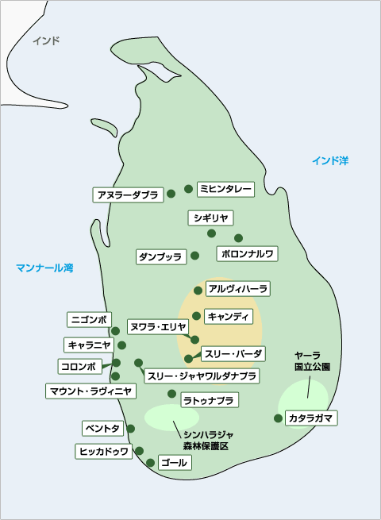
*Rf. W

Slide 8
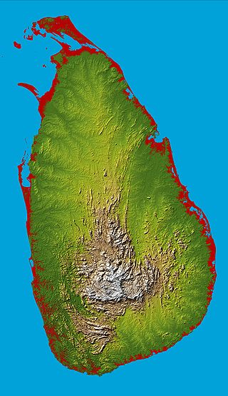
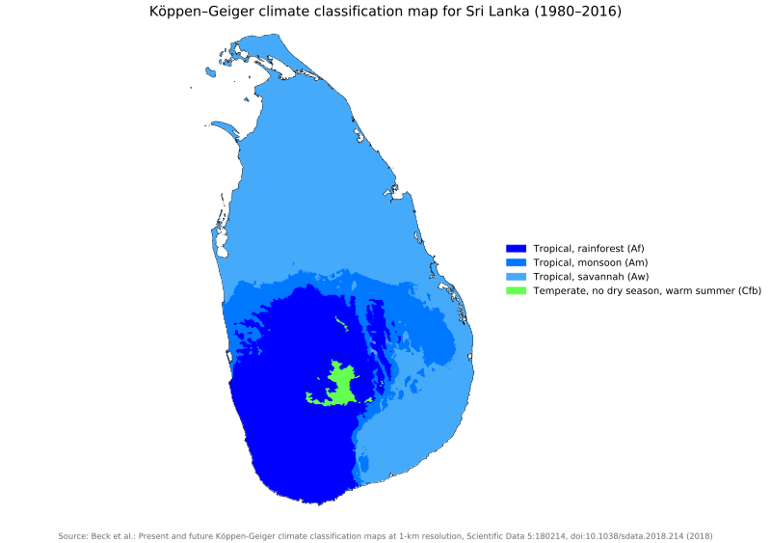
Jamaica Fundamentals
Geography, climate:
*Rf.W

Slide 9
Geography:(Sri Lanka):
Locates below the India and very close to the Equator.
Consists mostly of flat to rolling coastal plains
Has Mountains rising only in the south-central part.
The highest mountain is Pidurutalagala, reaching 2,524 metres.
Has 103 rivers. The longest one is the Mahaweli River, extending 335 KM.
Has 51 natural waterfalls of 10 meters or more due to much rainfall. The highest is Bambarakanda Falls, with a height of 263 metres (863 ft).
Climate: (*Rf.W)
Climate is tropical, with hot and humid weather.
Average yearly temperatures range from 28 °C to nearly 31 °C .
Higher inland regions are more temperate.
Rainfall pattern is influenced by monsoon winds from the Indian Ocean and Bay of Bengal. The central highlands is “wet zone” and receives up to 2,500 mm of rains annually.
Most of the east, southeast, and northern parts of Sri Lanka comprise the "dry zone", and receives not much rain annually ( 1,200 and 1,900 mm).
*Rf.W

Slide 11
Sri Lanka Major Cities & Populations:
Total Population of Sri Lanka is about 21.03 million in 2016.
Sri Lanka is divided into 9 provinces.
The capital of Sri Lanka is Sri Jayewardenepura Kate (polulation:107,925) near Colombo.
Major cities in Sri lanka concentrated in Western province: Colombo (561,314), Kaduwla(252,041), Maharagama(196,423), Kesbewa(185,122). All surrounding Colombo
Also, each provincial capital has reasonable big population: Kandy (98,828), Galle(86,333), Batticaloa(86,227), Jaffa(74,193), Anuradhapura(50,595), Ratunapura
*Rf.W

Slide 12
Sri Lanka Fundamental 1 : Provinces (9)
*Ja ffna
Northern Provinces
(Ja ffna)
2. North Central Provinces
(Anuradhapura)
3. North Western Provinces
(Kurunegala)
4. Eastern Provinces
(Trincomalee)
5. Central Provinces
(Kandy)
6. Western Provinces
(Colombo)
7. Uva Provinces
(Badula)
8. Sabaragamuwa Province
(Rantapura)
9. Southern Province
(Galle)
*Trincomalee
*
Anuradhapura
*Kurunegala
*Kandy
*Colombo
*Badula
Sri # Jayawardenepura Kotte
*Rantapura
*Galle
*Rf.W

Slide 13
Province and populations
*Rf.W
Province | Capital | Area (km2) | Area (mi2) | Population
Central | Kandy | 5,674 | 2,191 | 2,556,774
Eastern | Trincomalee | 9,996 | 3,859 | 1,547,377
North Central | Anuradhapura | 10,714 | 4,137 | 1,259,421
Northern | Jaffna | 8,884 | 3,430 | 1,060,023
North Western | Kurunegala | 7,812 | 3,016 | 2,372,185
Sabaragamuwa | Ratnapura | 4,902 | 1,893 | 1,919,478
Southern | Galle | 5,559 | 2,146 | 2,465,626
Uva | Badulla | 8,488 | 3,277 | 1,259,419
Western | Colombo | 3,709 | 1,432 | 5,837,294
Districts and local authorities Sri Lanka is also divided into 25 districts.^{[211]} Each district is administered under a

Slide 14
Sri Lanka Fundamentals
Sri Lanka`s Major Cities:
*Rf.W

Slide 15
Sri Lanka`s Major Cities
*Rf.W
(2012 Department of Census and Statistics enumeration)
Rank | City Name | Province | Pop. | Rank | City Name | Province | Pop.
1 | Colombo | Western | 561,314 | 11 | Galle | Southern | 86,333
2 | Kaduwela | Western | 252,041 | 12 | Batticaloa | Eastern | 86,227
3 | Maharagama | Western | 196,423 | 13 | Jaffna | Northern | 80,829
4 | Kesbewa | Western | 185,122 | 14 | Matara | Southern | 74,193
5 | Dehiwala-Mount Lavinia | Western | 184,468 | 15 | Gampaha | Western | 62,335
6 | Moratuwa | Western | 168,280 | 16 | Katunayake | Western | 60,915
7 | Negombo | Western | 142,449 | 17 | Boralesgamuwa | Western | 60,110
8 | Sri Jayawardenepura Kotte | Western | 107,925 | 18 | Kolonnawa | Western | 60,044
9 | Kalmunai | Eastern | 99,893 | 19 | Anuradhapura | North Central | 50,595
10 | Kandy | Central | 98,828 | 20 | Trincomalee | Eastern | 48,351

Slide 16
Major Cities of Sri Lanka
Sri Jayawardenepura Kotte:
Commonly known as Kotte, is the official, administrative capital of Sri Lanka. It is a satellite city and is located within the urban area of Colombo.
Colombo:
Commercial capital and largest city of Sri Lanka by population. According to the Brookings Institution, Colombo metropolitan area has a population of 5.6 million and 752,993 in the city proper.
Kandy:
Major city in Sri Lanka and is the capital of Central Province. It was the last capital of the ancient kings' era of Sri Lanka. It is both an administrative and religious city , and is the home of the Temple of the Tooth Relic (Sri Dalada Maligawa), one of the most sacred places of worship in the Buddhist world.
Galle :
It is situated on the southwestern tip and is the administrative capital of Southern Province. It was once as the main port on the island before the arrival of Portuguese in the 16th century.
*Rf.W

Slide 17
Jaffna:
It is the capital city of the Northern Province. Jaffna's suburb Nallur, served as the capital of the four-century-long medieval Jaffna Kingdom. The majority of the city's population are Sri Lankan Tamils 。Most Sri Lankan Tamils are Hindus followed by Christians, Muslims and a small Buddhist minority.
Anuradhapura:
It is the capital city of North Central Province. It is one of the ancient capitals of Sri Lanka, famous for its well-preserved ruins of an ancient Sinhala civilization. It is one of the oldest continuously inhabited cities in the world and one of the eight World Heritage Sites of Sri Lanka.
Kurunegala :
It is the capital city of the North Western Province. It was an ancient royal capital for 50 years in end of 13th century to the start of the 14th century. There are eight very noticeable large rocks that encircle and dominate the city. The largest among them is Ethagala or the "Elephant Rock" reaches 325 meters.
Ratnapura:
It is the capital city of Sabaragamuwa Province and is a traditional center for the Sri Lankan gem trade. The name 'Ratnapura' is a Sanskrit word meaning "city of gems".
*Rf.W

Slide 18
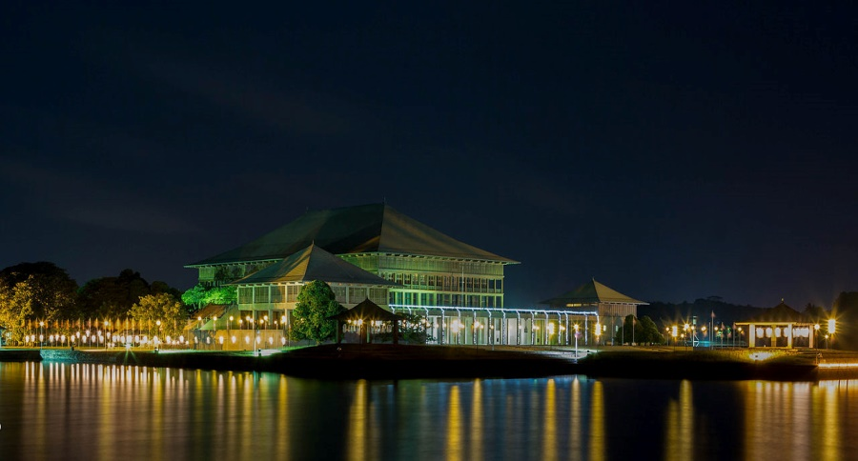
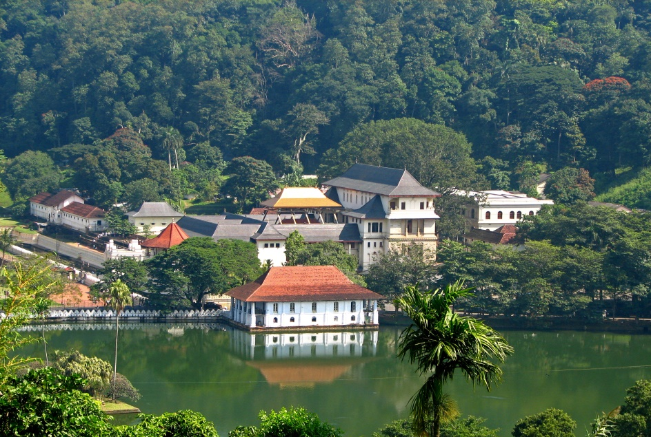
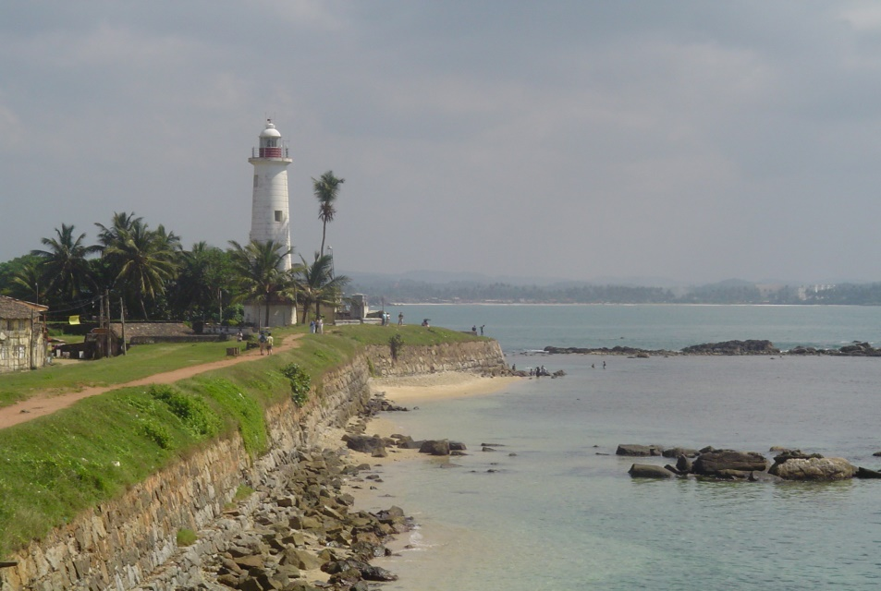
Sri Lanka Major Cities
*Rf.W
Sri Jayawardenepura Kotte:
Colombo:
Kandy
Galle

Slide 19
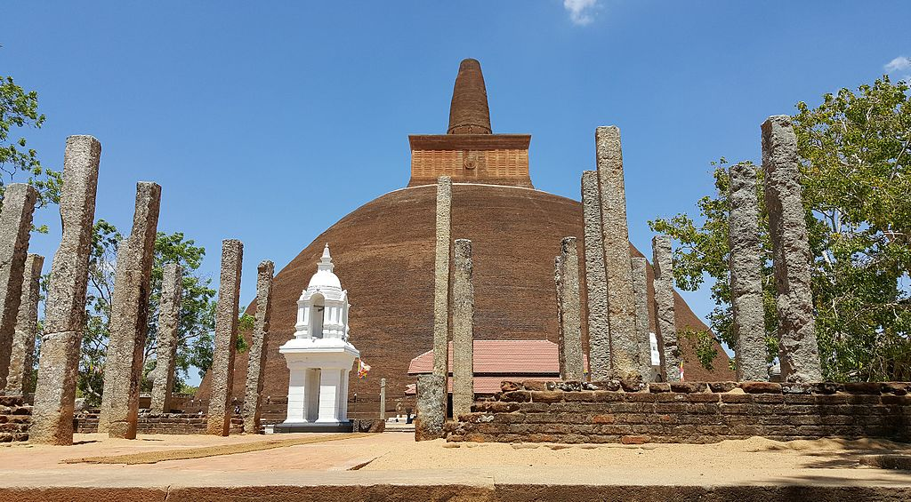
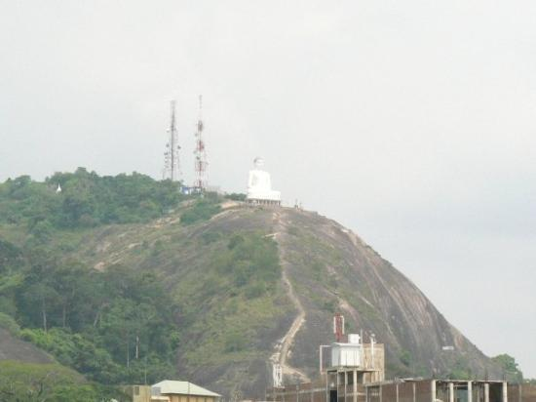
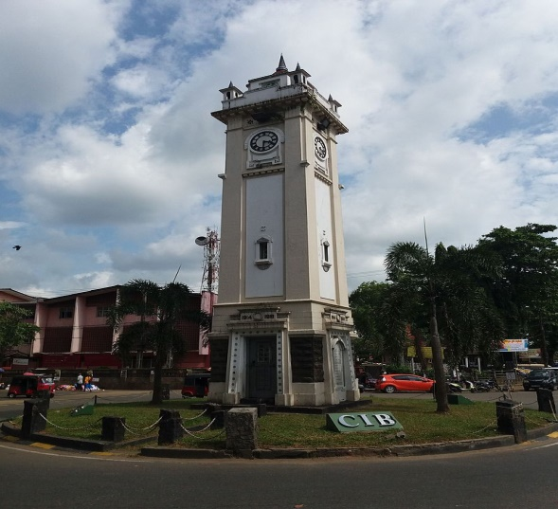
Jaffna:
Anuradhapura:
Kurunegala :
Ratnapura:

Slide 20
Brief History of Sri Lanka(*RFW)
Time Events
-------------------------------------------------------------------------------
BC483 Prince Vijaya (Sinhalese ancestor) landed in Sri Lanka. Sinhala
dynasty construction
BC 250 Buddhism Arrived
AC 1505 Portuguese visits (colonize coastal area)
AC 1658 Dutch visit (colonize coastal area)
AC 1802 By the Treaty of Amiens, Sri Lanka became as British colony.
AC 1815 The Kandy dynasty, the last Sri Lankan dynasty, was abolished and
the whole island was colonized by the UK.
AC 1948 Independent as a territory within the Commonwealth
AC 1956 Inaugurated as Prime Minister Bandaranaike. Enacted an official language law with only Sinhala as the official language.
AC 1972 Changed the country name to the Republic of Sri Lanka (completely independent from the British Commonwealth Ceylon)
AC 1978 Feb. Inauguration of President Jayawaldana (Establishment of Presidential System with Real Power)

Slide 21
Brief History of Sri Lanka
AC 1978 September : Changed the country name to Sri Lankan Democratic Socialist Republic)
AC 1983 July: Full-scale civil war with the Liberation Tigers of Tamil Eelam (LTTE)
AC 1978 July: Sri Lanka-India Peace Agreement signed, Indian Peacekeeper (IPKF) stationed in Sri Lanka)
AC 1987 November : Constitutional revision (Sinhala and Tamil are defined as official languages. State council system introduced)
2004 December : The Great Sumatra Earthquake and the Indian Ocean Tsunami affected all coasts except northwestern Sri Lanka, killing more than 30,000 people.
2009 May: Government troops capture all northern LTTE controlled areas. The civil war is over.)
Rf.MJ

Slide 22
Industry & People
Industry :
While the production and export of tea, rubber, coffee, sugar, and other commodities remain important, industrialization has increased the importance of food processing, textiles, telecommunications, and finance.
The country's main economic sectors are tourism, tea export, clothing, rice production, and other agricultural products. In addition to these economic sectors, overseas employment, especially in the Middle East, contributes substantially in foreign exchange.
People: Total of about 21.03 million in 2016.
74.9% Sinhalese
11.2% Sri Lankan Tamils (Hindu, etc.)
9.2% Sri Lankan Moors (Muslim People)
4.2% Indian Tamils
0.5% Others (incl. Burghers(Foreign origin), Malays, Veddas, Chinese,
Africans)
*Rf.W

Slide 23
Language
Language:
Sinhala and Tamil are the two official languages of Sri Lanka.
The Constitution defines English as the link language. English is widely used for education, scientific and commercial purposes.
Members of the Burgher (foreign origin)community speak variant forms of Portuguese Creole and Dutch with varying proficiency, while members of the Malay community speak a form of Creole Malay that is unique to the island.
*Rf.W

Slide 24
Culture
Sri Lanka culture dates back over 2500 years; Influenced primarily by Buddhism and Hinduism.
Sri Lanka is the home to two main traditional cultures: the Sinhalese (centered in the ancient cities of Kandy and Anuradhapura) and the Tamil (centered in the city of Jaffna).
In more recent times, the British colonial culture has also influenced the locals.
Cuisine:
- Dishes include rice and curry, pittu, kiribath, wholemeal roti, string hoppers,
wattalapam、 kottu, and hoppers. Jackfruit may sometimes replace rice.
Traditionally food is served on a plantain leaf or lotus leaf.
- Middle Eastern influences and practices are found in traditional Moor dishes,
while Dutch and Portuguese influences are found with the island's Burgher
community preserving their culture through traditional dishes such as Lamprais
(rice cooked in stock and baked in a banana leaf), Breudher (Dutch Holiday
Biscuit), and Bolo Fiado (Portuguese-style layer cake).
－In April, Sri Lankans celebrate the Buddhist and Hindu new year festival.

Slide 25
Culture
Sports：
While the national sport in Sri Lanka is volleyball
By far the most popular sport in the country is cricket.
Rugby union also enjoys extensive popularity, as do athletics, football (soccer), netball and tennis.
Sri Lanka's schools and colleges regularly organize sports and athletics teams, competing on provincial and national levels.
*Rf.W

Slide 26
Sports with Tokyo 2020 Olympic
Rio 2016 (Sri Lanka Team) participated 9 members(seven men and two women) in six different sports: Track and Fields, Badminton, Judo, Shooting, Swimming, and weight lifting.
Tokyo 2020 (??):
Track & Field, Swimming, Badminton,
Tekondo, Tennis, Shooting, Weight lifting,
Canoeing, Karate, Equestrian, Baseball, etc.

Slide 27
Sightseeing Place
There are 8 world heritages in Sri Lanka.
1. Polonnaruwa: (Ancient City of Polonnaruwa )
Polonnaruwa was the second capital of Sri Lanka after the destruction of Anuradhapura in 993. Historical monuments and garden city created in the 12th century.
2. Sigiriya: (Ancient City of Sigiriya)
The ruins of the capital built by the parricidal King Kassapa I (477–95) lie on the steep slopes and at the summit of a granite peak standing some 180m high.
3. Anuradhapura: (Sacred City)
Anuradhapura, a Ceylonese political and religious capital that flourished for 1,300 years, was abandoned after an invasion in 993. Hidden away in dense jungle for many years but now avilable.
*Rf.WF

Slide 28
Sightseeing Spot
4. Galle:(Old Town of Galle and its Fortifications)
Founded in the 16th century by the Portuguese and lasted by 18th century. The best example of a fortified city built by Europeans in South and South-East Asia.
5. Kandy:(Sacred City)
This Kandy was the last capital of the Sinhala kings whose patronage enabled the Dinahala culture to flourish for more than 2,500 years until British occupation in 1815. Also the Temple of the Tooth Relic (the sacred tooth of the Buddha) is a famous pilgrimage site.
6. Dambulla( Rangiri Dambulla Cave Temple)
A sacred pilgrimage site for 22 centuries, this cave monastery, with its five sanctuaries, is the largest, best-preserved cave-temple complex in Sri Lanka. The Buddhist mural paintings (covering an area of 2,100 m² ) are of particular importance, as are the 157 statues.
*Rf.WF

Slide 29
Sightseeing Spot
7. Sinharaja Forest Reserve
Located in south-west Sri Lanka, Sinharaja is the country's last viable area of primary tropical rainforest. More than 60% of the trees are endemic and many of them are considered rare. There is much endemic wildlife, especially birds, but the reserve is also home to over 50% of Sri Lanka's endemic species of mammals and butterflies, as well as many kinds of insects, reptiles and rare amphibians.
8. Central Highlands of Sri Lanka
Sri Lanka's highlands are situated in the south-central part of the island. The property comprises the Peak Wilderness Protected Area, the Horton Plains National Park and the Knuckles Conservation Forest. These montane forests, where the land rises to 2,500 metres above sea-level, are home to an extraordinary range of flora and fauna, including several endangered species such as the western-purple-faced langur, the Horton Plains slender loris and the Sri Lankan leopard. The region is considered a super biodiversity hotspot.
*Rf.WF

Slide 30
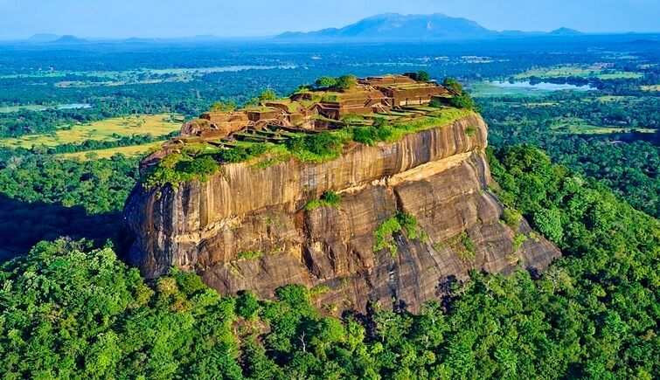
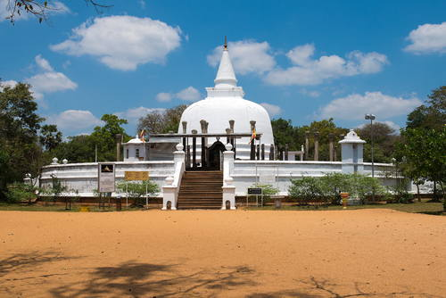
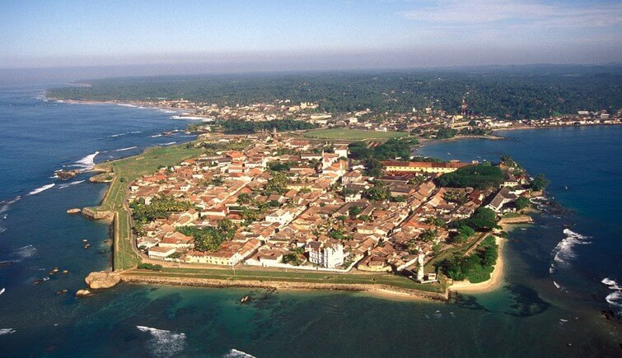
Polonnaruwa:
Sigiriya:
*Rf.W
Kandy:(Sacred City)
Galle:
*Rf.WF

Slide 31
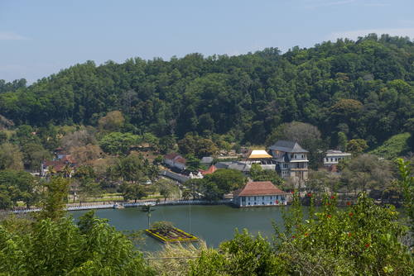
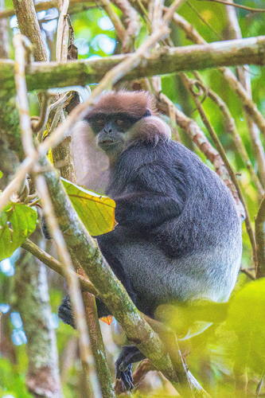
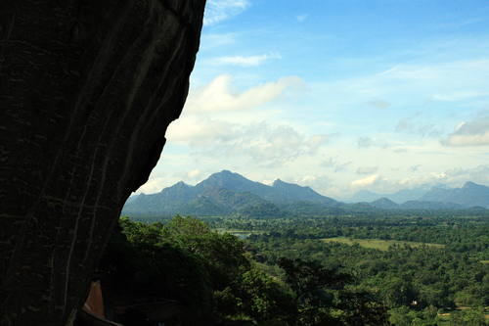
Kandy:(Sacred City)
Dambulla: (Cave Temple)
. Sinharaja Forest Reserve
Central Highlands of Sri Lanka

Slide 32
Saji-san’s best 5 recommendations to visit in Sri Lanka.
1. Safari in Sri Lanka
2.
3.
4.
5.

Slide 33
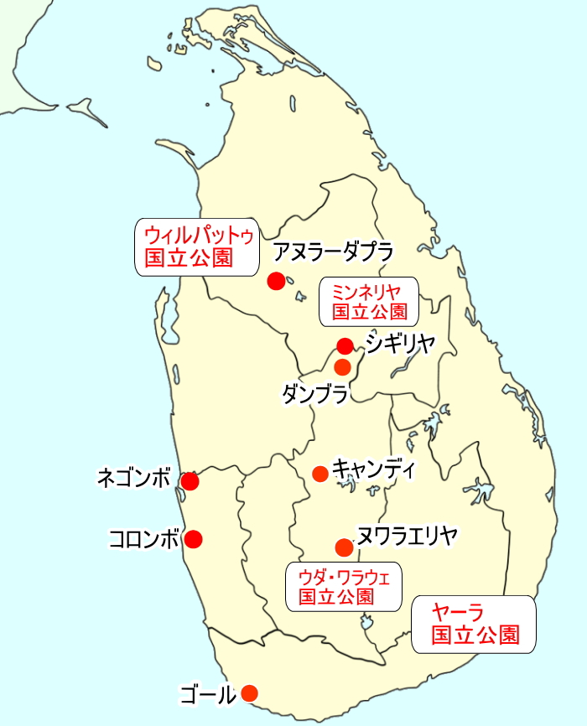
Safari in Sri lanka
スリランカでサファリをするなら、この国立公園がおすすめ！
ミンネリヤ国立公園, ヤーラ国立公園, ウダワラウェ国立公園, ウィルパットゥ国立公園,その他。

Slide 34
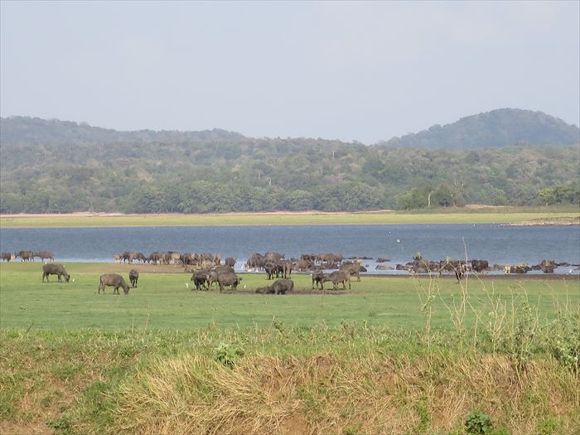

Slide 35
ミンネリヤ国立公園：
多い時には１００頭以上の象が集まる！エレファント・ギャザリングで有名な、ミンネリヤ国立公園. この公園では、時期を選べばかなり高い確率で野生の象に出会える国立公園です。ベストシーズンの７月～１０月はこの地域の乾季にあたり、象たちが水を飲むために湖に集まります。これはエレファント・ギャザリングと呼ばれ、多い時には１００頭以上の象の群れに出会うことができます.
ベストシーズン以外の時期は、象が近くの他の国立公園へ移動しますが、その日の様子はサファリを案内するレンジャーたちが把握しているため、彼らが連絡を取り合って場所を変え、近くにあるフルルエコパーク（２～５月）やカウドゥラ国立公園（１２～２月）などに案内してくれます。
ヤーラ国立公園:
この国立公園は、スリランカで２番目に大きな国立公園で、出会える動物の種類が多いのが特徴です。何と４４種類の哺乳類と２１５種類の野鳥が生息しており、サファリでは様々な動物を見ることができます。さらに、スリランカのビッグ５と言われるうちの３つ、レパード（スリランカヒョウ）・ナマケグマ・象に会うことができる国立公園です。（あとの２つはシロナガスクジラとマッコウクジラで、陸にはいません）ヤーラ国立公園は他の地域と異なる植生を持ち、草木の様子もいろいろ。

Slide 36
ウダワラウェ国立公園
この国立公園は、ヤーラ国立公園の近くにあり、野生の象が多数生息している国立公園で、敷地内には公園内で迷子になった小象を育てる、小さな象の孤児院もあります。
ベストシーズンは１月～６月で、場所はスリランカ南部に位置し、ヤーラ国立公園から車で約１時間半の場所にあるため、一度のスリランカ旅行でヤーラ国立公園とウダワラウェ国立公園、２つのサファリを楽しむのもおすすめです。
ウィルパットゥ国立公園：
この公園は、スリランカで最大の広さを持つ国立公園で、公園の面積は１３１５ｋ㎡あります（東京２３区の約２倍）。スリランカの北西部、世界遺産・アヌラーダプラから車で約１時間の場所にあり、野生の象だけではなくナマケグマやイノシシ、鹿などの動物がいることでも有名ですが、なんといってもウィルパットゥ国立公園の一番のターゲットは野生のレパード（スリランカヒョウ）です。
動物の種類はヤーラ国立公園が多いのですが、レパードの数はウィルパットゥ国立公園の方が多いため、とにかくレパードを見たい！という方には最もおすすめの国立公園です。
サファリのベストシーズンは２月～９月です。ヤーラのように定期的にクローズすることはないのですが、コンディションによってはクローズすることもあるため、ツアーは注意が必要です。
*From Japan e-tour web site.

Slide 37
Ms. Saji`s corner
How to get to Sri Lanka from Japan and about how long does it take you to get to your hometown?
What is the best seasons to visit Sri Lanka?

Slide 38
Questions about Sri Lanka
Where is Sri Lanka located?
What is the name of the capital of Sri Lanka?
What is the population of Sri Lanka?
What are the major cities in Sri Lanka?
What is the climate of Sri Lanka?
Who is the fist European that visited Sri Lanka?
What are the popular sports in Sri Lanka?
What are the popular sight seeing spots
in Sri Lanka that you learned in this session?
9. How far from Japan to Sri Lanka?

Slide 39
Question and answer
Any questions to Saji-san on Sri Lanka?
Free discussion:
Let make a small group
Introduce your-self,
Share your travel experiences:
Best place(s) to visit,
Anything that needs to be paid attention in travel, etc.,
Make a friend if possible.

Slide 40
Refernces
*Rf.W - Wikipedia Sri Lanka
*Rf.G - from Google.
*Rf.MJ - Ministry of foreign affairs of Japan
*Rf.WF - World Heritage website.

